Slide 1
Boosting AI Performance with GPUs, TPUs, and Emerging Hardware Paradigms
Sai Anoushka K
Notes:
Good afternoon everybody, today im going to talk about my topic - Boosting AI performance with GPU’s, TPU’s and Emerging Hardware Paradigms

Slide 2
What We’ll Cover
Introduction to AI Hardware Needs.
Evolution of GPUs and TPUs.
Detailed Architectures.
GPU vs. TPU: Performance Trade-offs
Green Computing and Energy Efficiency.
Emerging Hardware (ROCm, FPGAs).
Notes:
Here’s a quick overview of what we’ll be covering today. First, we’ll discuss the need for specialized hardware. Then, we’ll explore the evolution and architecture of GPUs and TPUs, their performance trade-offs before addressing energy efficiency and green computing. Finally, we’ll touch on emerging trends like ROCm and FPGAs

Slide 3
Why do we need specialised Hardware ?
AI tasks like massive computational power.
Massive parallelism in AI is best handled by GPUs and TPUs.
CPUs struggle to meet AI's parallel processing demands.
GPUs and TPUs excel in training and inference for AI tasks.
Optimized hardware lowers costs with better performance per watt and dollar.
Specialized hardware ensures low latency for real-time applications like autonomous driving.
Notes:
So what is the need for specialised hardware?
-Artificial intelligence tasks like training massive deep learning models require computational power far beyond what traditional CPUs can handle. - Autonomous driving as an example—processing real-time video feeds while making split-second decisions is a massive computational challenge.
- This is where GPUs and TPUs come in.
- GPUs excel in parallel processing, allowing them to handle multiple operations simultaneously. Meanwhile, TPUs are specifically designed for tensor-heavy operations, making them perfect for deep learning inference.
- Optimized hardware not only ensures better performance but also reduces costs, energy consumption, and latency, which are critical for real-time applications like robotics and smart cities

Slide 4
Graphic Processing Unit (GPU)
GPUs (Graphics Processing Units) are specialized processors designed for parallel computations.
Originally created for rendering images and graphics in gaming and multimedia applications.
Now used for data-intensive AI workloads, especially in training neural networks
How do they excel in AI?
Parallelism: Thousands of cores execute multiple tasks simultaneously.
High Throughput: Optimized for matrix multiplications and tensor operations in AI models.
Programmability: Frameworks like CUDA (Compute Unified Device Architecture) allow developers to optimize GPU performance for AI applications.
Notes:
GPUs, or Graphics Processing Units, were initially developed to render images in video games. However, their architecture, designed for parallelism, made them ideal for artificial intelligence. Imagine a single GPU with thousands of cores, all working together to process massive datasets—this is why GPUs became the backbone for training deep learning models.
Parallelism allows GPUs to execute thousands of operations simultaneously.
For example, training a neural network involves billions of matrix multiplications, and GPUs handle these efficiently.
With frameworks like CUDA, GPUs can now handle tasks far beyond gaming, including scientific simulations and AI applications.
Their programmability and hight throughput make them perfect for AI workloads.

Slide 5
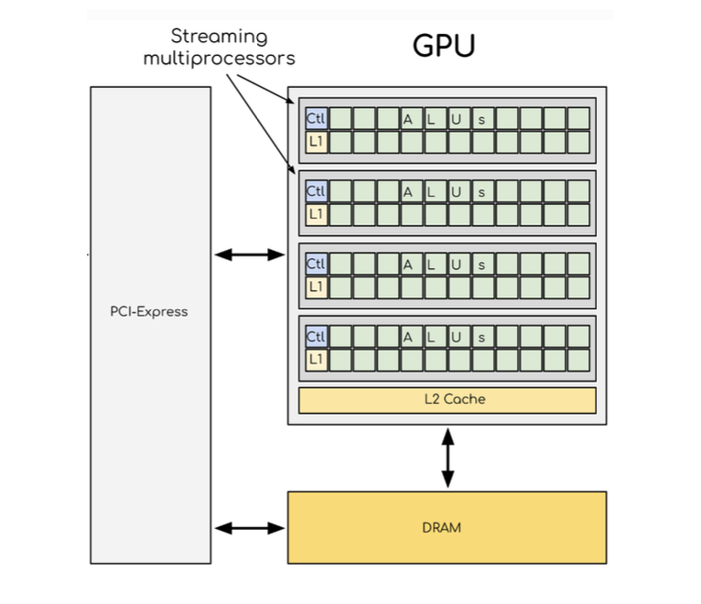
GPU Architecture
Streaming Multiprocessors (SMs):
Handle the majority of parallel computation.
Contains Arithmetic Logic Units (ALUs), control logic, and L1 cache.
Memory Hierarchy:
L1 and L2 Cache: Reduces latency for frequently accessed data.
DRAM: Stores data required for computations.
PCI-Express Interface:
Connects GPU to CPU for data transfer.
Can introduce bottlenecks in large data transfers.
Notes:
- GPUs are built for parallel processing, which means they can handle multiple tasks simultaneously. - At the core of the GPU architecture are Streaming Multiprocessors (SMs), which are clusters of processing units. - Each SM contains Arithmetic Logic Units (ALUs) for performing calculations, L1 cache for quick data access, and control logic to coordinate operations. These components work together to ensure efficient execution of parallel tasks.
- GPUs rely on a combination of L1 and L2 caches to reduce data access times. - the DRAM provides the bulk of storage for computations. However, accessing DRAM is slower, which is why the cache system is so essential.
- The PCI-Express interface connects the GPU to the CPU, allowing data to flow between them. While this connection is fast, it can sometimes become a bottleneck, especially for data-heavy applications

Slide 6
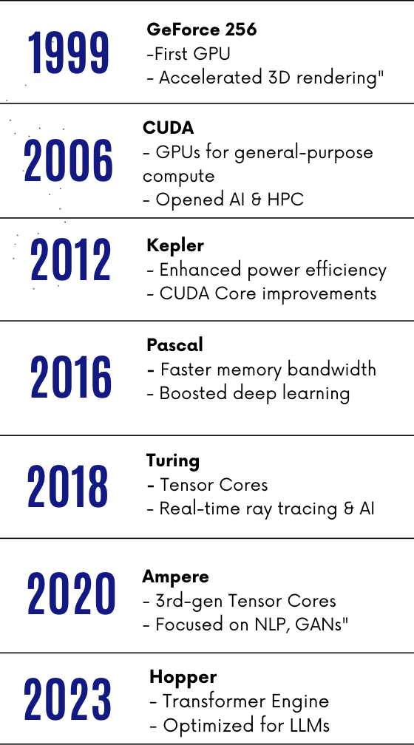
GPU Evolution
1999 - GeForce 256: First GPU for 3D rendering, revolutionizing parallel processing.
2006 - CUDA: Enabled general-purpose GPU computing, unlocking AI and HPC applications.
2012 - Kepler: Enhanced power efficiency and introduced CUDA Core improvements.
2016 - Pascal: Increased memory bandwidth and boosted deep learning performance.
2018 - Turing: Introduced Tensor Cores, optimizing AI tasks and enabling real-time ray tracing.
2020 - Ampere: Third-gen Tensor Cores, focused on NLP and GAN optimizations.
2023 - Hopper: Designed for LLMs, leveraging Transformer Engine for accelerated AI tasks.
Notes:
- Let’s start with the 1999 NVIDIA GeForce 256, which was the world’s first GPU. It was designed for 3D rendering and revolutionized how graphics were handled. However, its capabilities were limited to graphical applications.
- The real breakthrough came in 2006 with the introduction of CUDA, or Compute Unified Device Architecture, by NVIDIA. CUDA allowed developers to use GPUs for general-purpose computing, not just graphics. For example, instead of rendering a 3D image, CUDA enables the GPU to train a neural network by performing millions of matrix multiplications simultaneously. CUDA brought programmability to GPUs, making them a core component of artificial intelligence and high-performance computing.
- In 2018, the Turing architecture introduced Tensor Cores, specialized units designed for deep learning operations like matrix multiplications. Tensor Cores use mixed precision—combining 16-bit and 32-bit operations—to improve performance while maintaining accuracy. This made Turing GPUs a game-changer for AI tasks.
- Finally, in 2022 and 2023, the Hopper architecture introduced the Transformer Engine, specifically designed for large language models like GPT-4. Hopper GPUs excel in AI tasks that require massive computation, such as training models for natural language processing and generative AI.

Slide 7
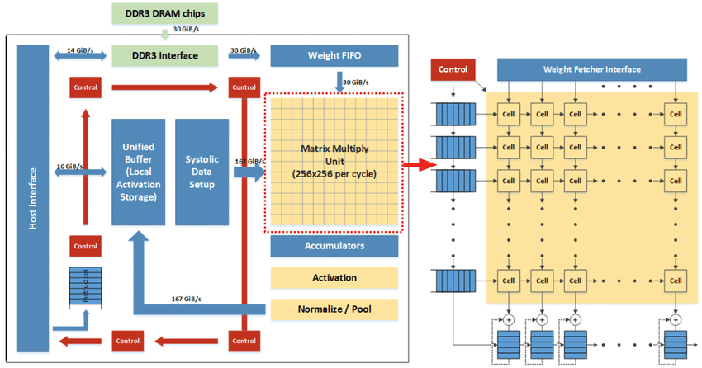
Tensor Processing Unit (TPUs)
Tensor Processing Units (TPUs) are custom-built by Google for deep learning tasks.
Optimized for tensor operations like matrix multiplication, central to neural networks.
First launched in 2015 for inference; later versions (TPU v2 and beyond) support training.
Widely integrated with Google Cloud for scalability in AI workloads.
Notes:
TPUs are specialized hardware designed by Google to accelerate AI computations. Unlike GPUs, which were originally developed for graphics rendering and later adapted for AI, TPUs are purpose-built for deep learning tasks.
The key optimization in TPUs is for tensor operations, such as matrix multiplications, which are at the core of neural networks. A single TPU can process massive amounts of data, making it highly efficient for AI workloads, particularly in inference tasks where speed and efficiency are critical.
The DDR3 DRAM Chips, this component stores the data and weights required for computation.
The Unified Buffer acts as a local cache to hold activations and intermediary results.
Then, we have the Systolic Data Setup, which pipelines data through the system in a highly efficient way to ensure no delays.
At the heart of the TPU is the Matrix Multiply Unit, or MMU. This unit processes large-scale matrix multiplications, specifically a 256x256 matrix per cycle. This is where the TPU gains its speed advantage over traditional GPUs.
Finally, the Weight Fetcher ensures that weight matrices are supplied at high speed for computation without creating bottlenecks.

Slide 8
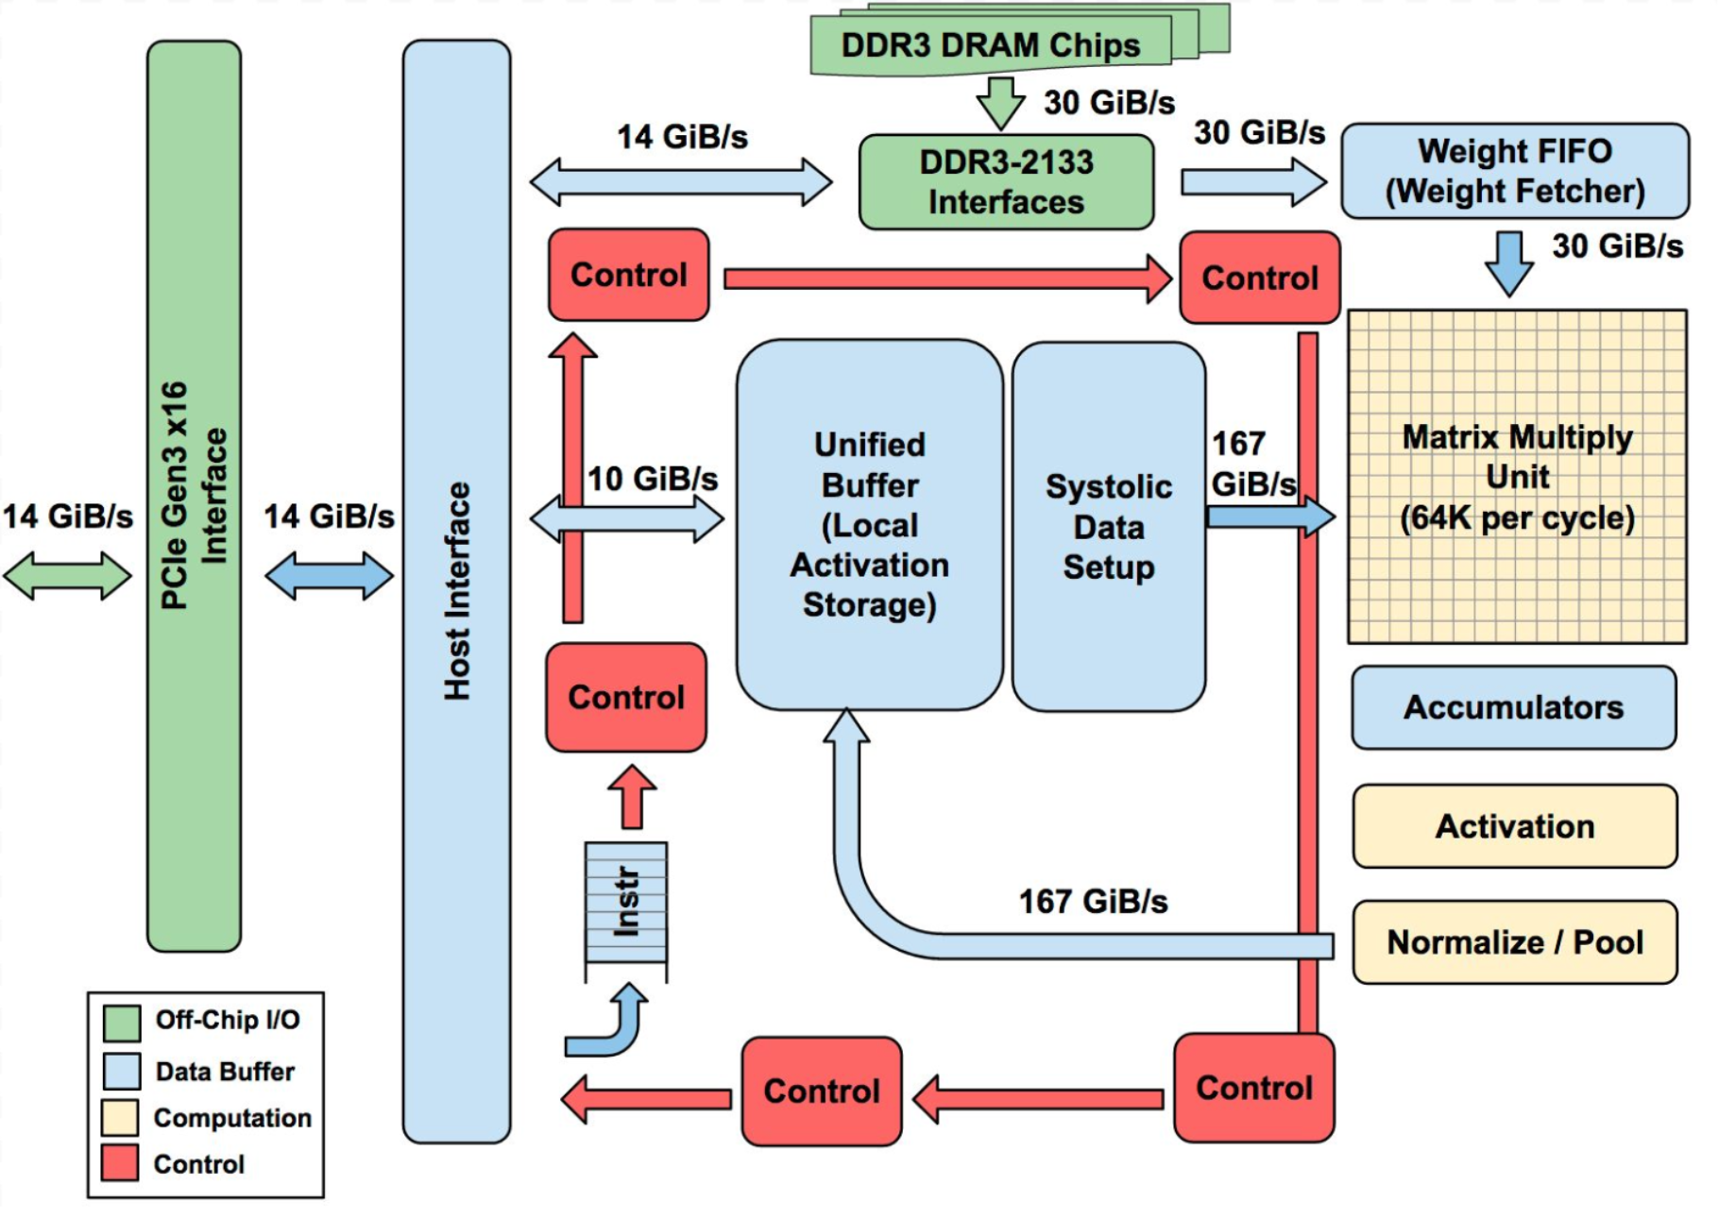
TPU Architecture and Evolution
Architecture Highlights:
Core component: Systolic array for efficient parallel processing of tensor operations.
Focus on high throughput and energy efficiency, especially for inference tasks.
Evolution:
TPU v1 (2015): High efficiency for inference.
TPU v2 (2017): Training support added, enhanced scalability.
TPU v3 (2018): Liquid cooling for improved performance.
TPU v4 (2021): Designed for massive AI workloads, improving efficiency.
Notes:
Now let’s move to the evolution of TPUs.
In 2015, Google introduced TPU v1, which was optimized solely for inference tasks.
Then, in 2017, Google released TPU v2, which added support for both training and inference, significantly improving scalability for larger models.
In 2018, Google introduced TPU v3, which incorporated liquid cooling to handle higher workloads and improve thermal efficiency.
Finally, in 2021, we saw TPU v4, designed for massive AI workloads with even greater efficiency and scalability.

Slide 9
GPU vs. TPU: Performance Trade-offs
Task-Specific Advantages:
GPUs excel in training AI models, handling dynamic and complex computations.
TPUs are optimized for batch inference tasks, delivering high throughput and low latency.
Energy Efficiency & Cost:
GPUs consume more power but are versatile across tasks.
TPUs provide better performance-per-watt for large-scale production.
Use Cases:
GPUs: Training LLMs like GPT-4 or computer vision models.
TPUs: Real-time applications like recommendation systems and voice recognition.
Notes:
Moving on, let’s compare GPUs and TPUs and explore the performance trade-offs between these two hardware accelerators.
GPUs, as we’ve seen earlier, are highly flexible and excel at training AI models. Their general-purpose architecture allows them to handle dynamic and complex computations, making them ideal for tasks like deep learning training, where models are updated iteratively.
On the other hand, TPUs are optimized for batch inference tasks. They deliver high throughput and low latency.
When we look at energy efficiency and cost, GPUs tend to consume more power due to their versatile design. However, TPUs provide better performance-per-watt, which is essential for large-scale production environments.
While GPUs are versatile and adaptable across various tasks, TPUs are more specialized and efficient for inference-heavy workloads.
In terms of use cases, GPUs are commonly used for training large language models like GPT-4 or complex computer vision models. TPUs, on the other hand, are preferred for real-time inference tasks, such as recommendation systems or virtual assistants, where low latency is crucial.

Slide 10
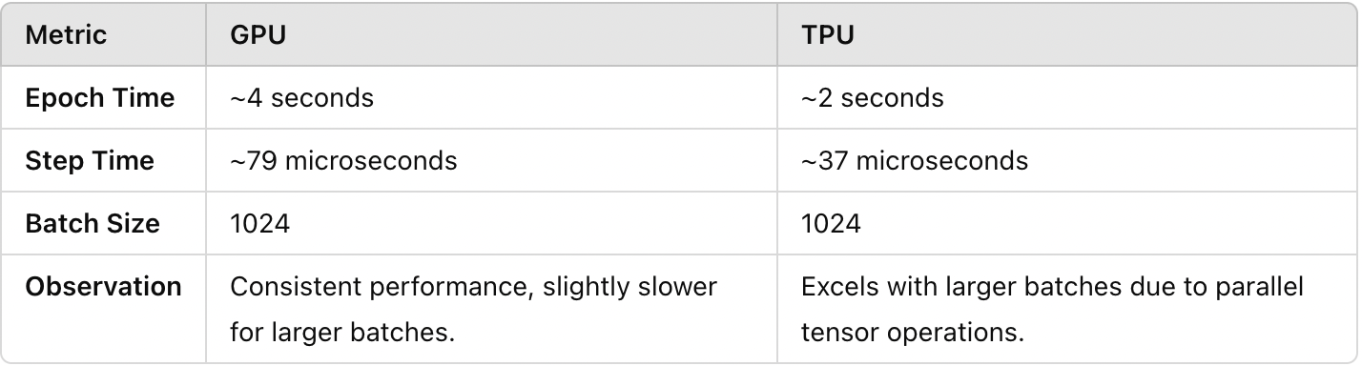
GPU vs. TPU: Performance Trade-offs
Dataset and Task:
Used the MNIST dataset (handwritten digits).
Task: Classify digits (0-9) using a Convolutional Neural Network (CNN).
Model and Architecture:
CNN with 2 convolutional layers, max-pooling, dropout, and dense layers.
Simple yet effective for evaluating performance.
Comparison Metrics:
Measured Epoch Time and Step Time for Batch Size = 1024.
Notes:
To illustrate these differences, let’s take a look at a case study where we used both GPUs and TPUs to classify digits from the MNIST dataset.
We used a simple Convolutional Neural Network (CNN) to classify handwritten digits from 0 to 9. The CNN included two convolutional layers for feature extraction, along with dropout layers for regularization and dense layers for final classification.
Both GPUs and TPUs were tested using the same batch size of 1024 to ensure a fair comparison. The results showed some interesting differences. TPUs completed an epoch in approximately 2 seconds, while GPUs took 4 seconds. Similarly, for step times, TPUs processed a batch in 37 microseconds, compared to 79 microseconds for GPUs.
This significant speed advantage of TPUs comes from their optimized systolic array architecture, which allows for faster and more efficient matrix operations. However, GPUs demonstrated consistent performance across all batch sizes, showcasing their flexibility and adaptability.
This comparison highlights the strengths of each hardware accelerator—TPUs excel in processing large batches due to their tensor-specific optimizations, while GPUs offer versatility for a wide range of tasks.

Slide 11
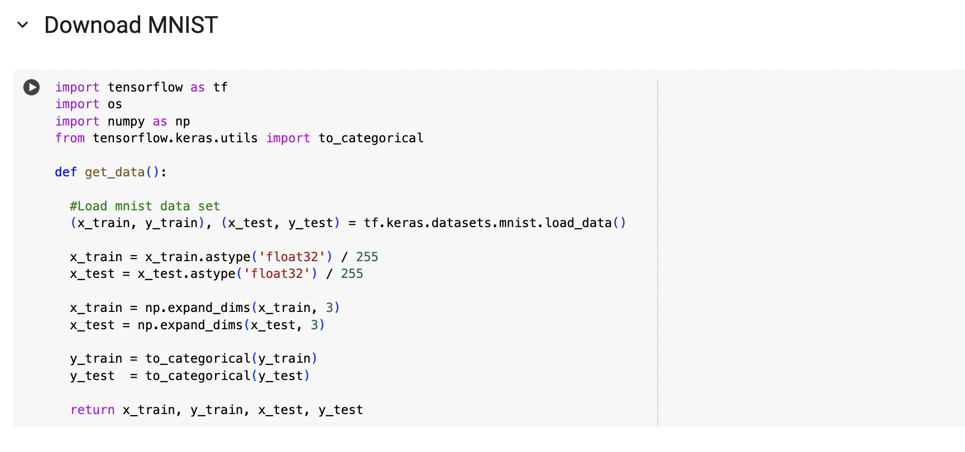

Slide 12
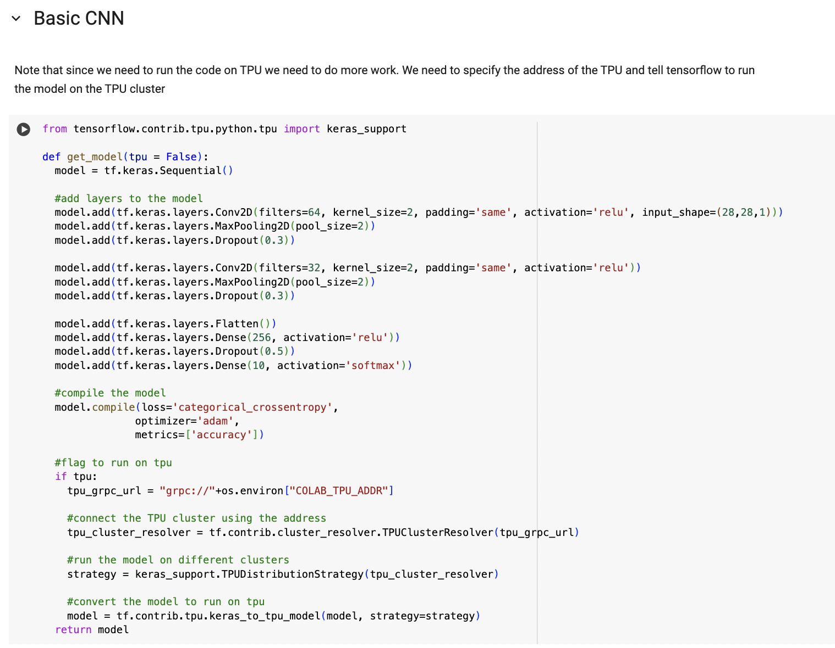

Slide 13
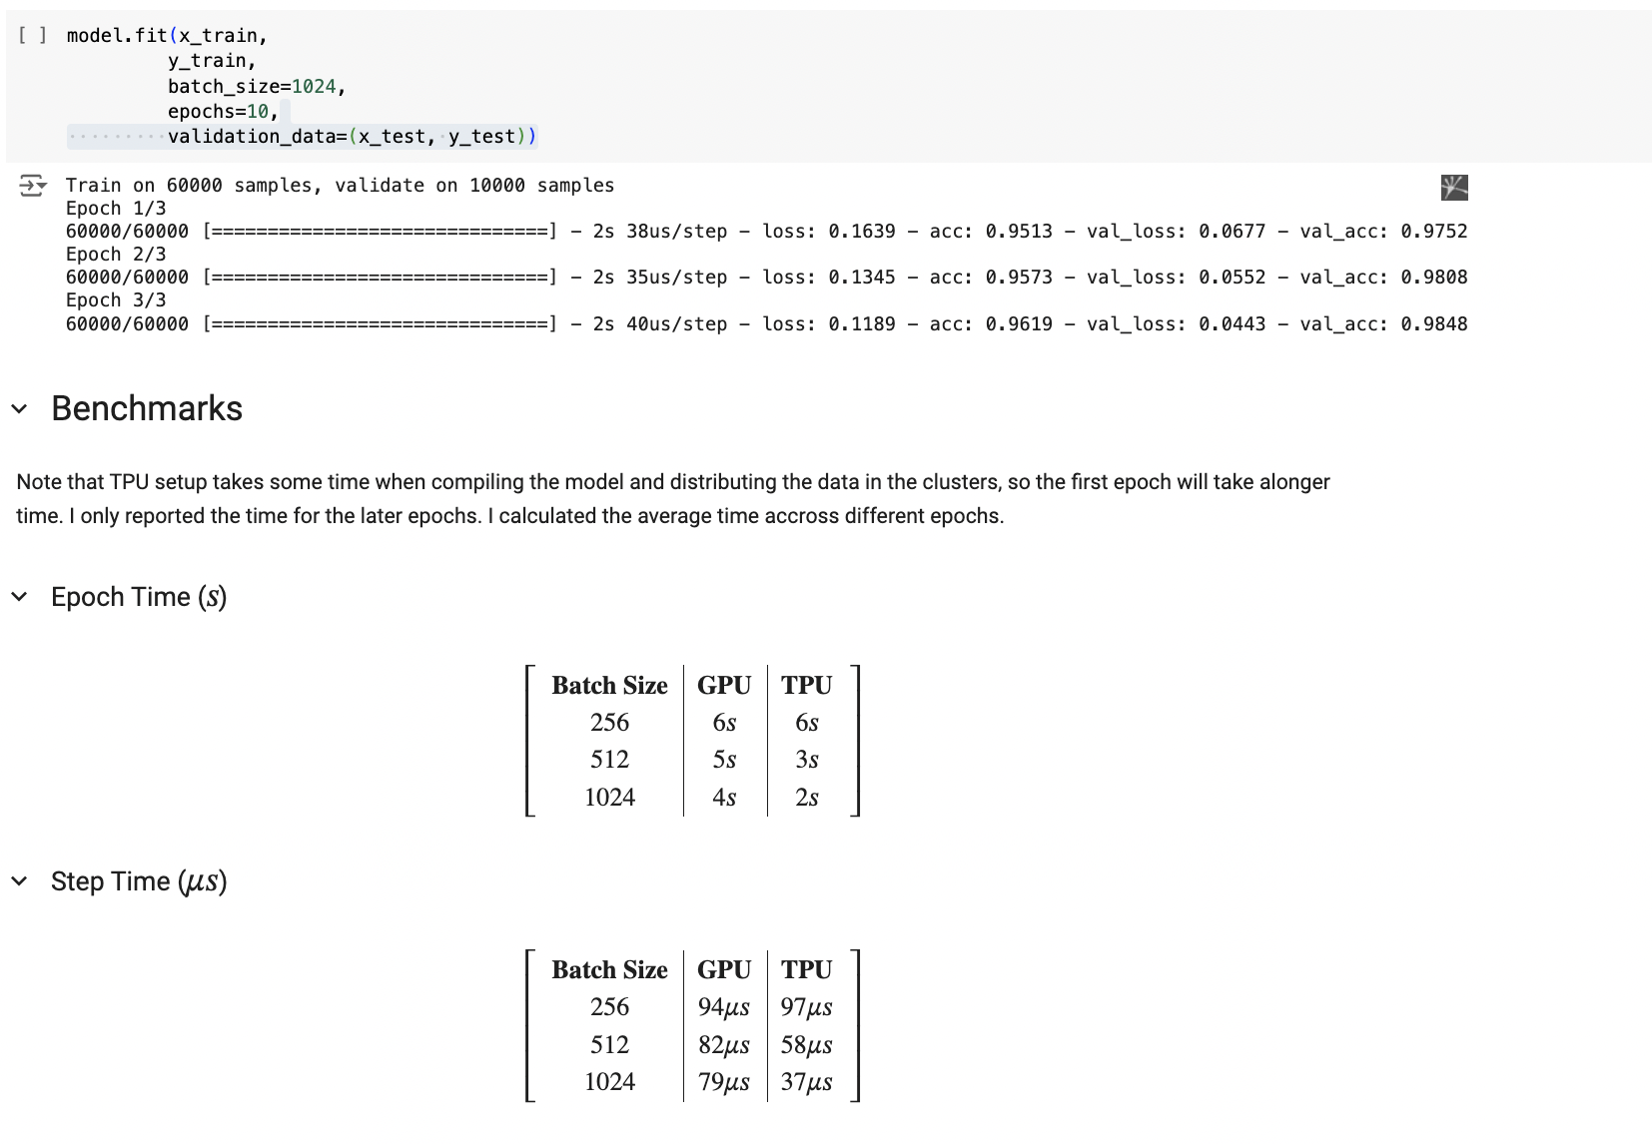
Notes:
You can see that with the increase in batch size, the time is reducing, this is due to effective utilization of the GPU's architecture. By processing more data in parallel, it results in decreased step times for larger batches.

Slide 14
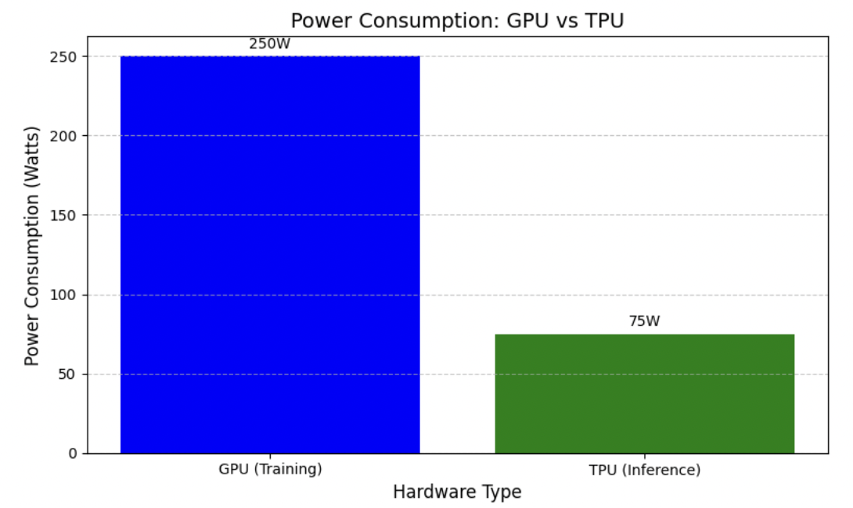
Addressing Energy Challenges in AI Hardware
Energy Consumption:
GPUs require high energy for tasks like training large language models (e.g., GPT-4).
TPUs are more energy-efficient, especially for inference tasks.
Environmental Impact:
AI hardware contributes to significant power usage in data centers.
Data centers are a major source of carbon emissions globally.
Solutions in Green Computing:
Google TPU v4: Designed to reduce power consumption
NVIDIA Ampere: Advanced tensor cores improve energy efficiency
Data centers adopting renewable energy (solar, wind, nuclear)
Future Directions:
Hardware optimizations focused on reducing energy wastage and heat production.
Exploring nuclear-powered data centers to drive down long-term environmental costs.
Notes:
First, let’s talk about energy consumption. Training large AI models, like GPT-4, requires significant power usage.
GPUs, which are predominantly used for training these models, often require upwards of 250 watts per unit during high-load operations.
On the other hand, TPUs, particularly in inference tasks, are designed to be more energy-efficient, consuming as little as 75 watts while maintaining performance. This efficiency makes TPUs an attractive solution for large-scale deployments.
The energy-intensive operations of GPUs and TPUs often run in data centers, which are major contributors to carbon emissions globally. this raises a sustainability concern, as these data centers also consume resources for cooling and maintenance.
So, what’s being done? Companies are now investing in green computing solutions. For instance, Google’s TPU v4 has been specifically designed to minimize power consumption during AI tasks. NVIDIA’s Ampere architecture also introduces advanced tensor cores, optimized for both performance and energy efficiency.
Furthermore, leading tech companies are transitioning to renewable energy sources—solar, wind, and nuclear—to power their data centers. This shift not only reduces their carbon footprint but also makes AI computation more sustainable.

Slide 15
New Accelerators and Platforms
ROCm: AMD’s Open-Source Platform
What is ROCm?
The Radeon Open Compute Platform (ROCm) by AMD is an open-source ecosystem designed to support AI and high-performance computing (HPC).
Offers an alternative to proprietary platforms like NVIDIA CUDA, promoting broader accessibility and innovation.
Features of ROCm:
Open-source, multi-platform support for GPUs.
Focuses on optimizing AI and ML workloads in high-performance environments.
Enables deep learning and HPC via frameworks like TensorFlow and PyTorch.
Used in large-scale data centers, particularly where cost efficiency and customization are priorities.
Advantages:
Open-source nature encourages adaptability and cost savings.
Scalable for large data centers and cloud platforms.
Notes:
The Radeon Open Compute Platform, or ROCm, is an open-source ecosystem developed by AMD to support AI and ML workloads. It serves as an alternative to proprietary platforms like NVIDIA CUDA, with an emphasis on accessibility and innovation.
Now, what makes ROCm stand out?
Features of ROCm include its multi-platform support, allowing seamless integration across different systems. ROCm is designed to optimize deep learning and high-performance workloads, and it works seamlessly with frameworks like TensorFlow, PyTorch, and even Kubernetes for deployment. It’s also widely adopted in data centers that prioritize cost efficiency and customization.
its open-source nature fosters adaptability and collaboration, enabling developers to build scalable solutions. It also reduces dependency on proprietary systems, lowering costs for large-scale AI deployments.

Slide 16
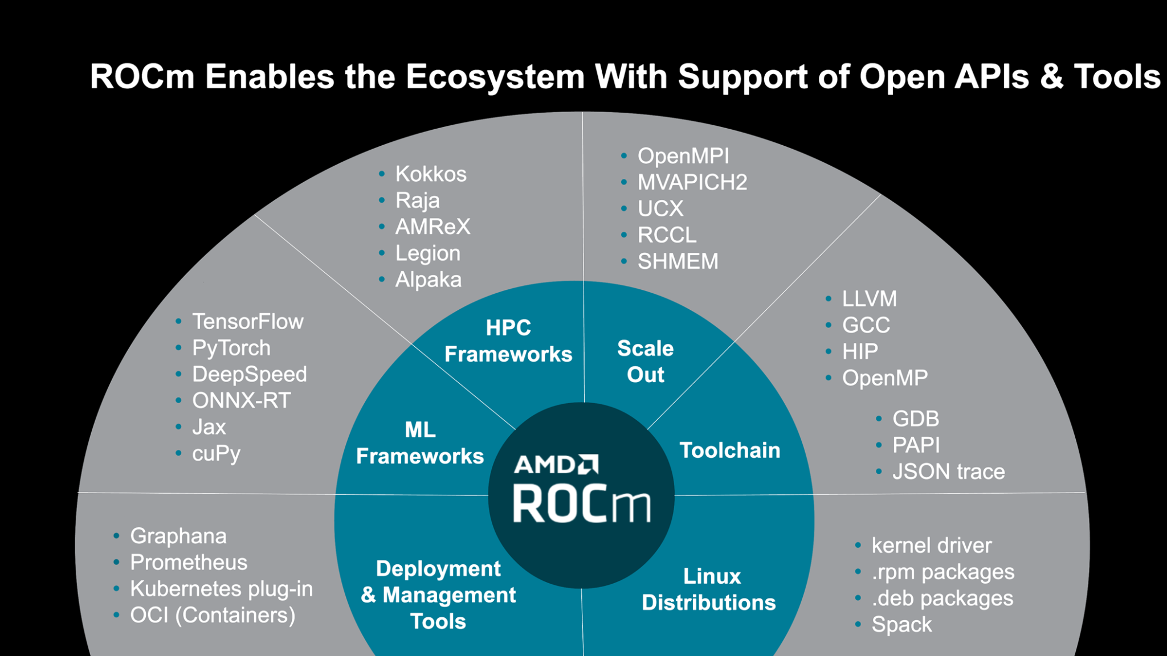
Notes:
This is ROCm ecosystem. At its core, ROCm supports frameworks like TensorFlow, PyTorch, and DeepSpeed, ensuring flexibility for machine learning tasks. Surrounding this are its extensive tools, like LLVM, OpenMP, and kernel drivers, which make deployment and scaling both efficient and user-friendly. This layered approach ensures ROCm caters to a broad range of use cases, from ML frameworks to deployment in cloud systems.
With AMD stepping into this space, we can expect further innovations that enhance both accessibility and efficiency in AI hardware platforms.

Slide 17
New Accelerators and Platforms
2. Field-Programmable Gate Arrays (FPGAs)
What are FPGAs?
Reprogrammable hardware capable of adapting to a variety of tasks, making them ideal for dynamic AI workloads.
Differ from GPUs/TPUs as they can be customized post-manufacture for specific applications.
Advantages of FPGAs:
Flexibility: Adjusted for evolving workloads, such as real-time processing in cybersecurity or financial trading.
Low latency: Exceptional for applications requiring rapid decisions, e.g., high-frequency trading or autonomous vehicles.
Energy Efficiency: FPGAs use power efficiently compared to traditional processors.
Real-World Applications:
Implemented in telecommunications for 5G networks for rapid processing.
Used in aerospace for adaptive signal processing and decision-making.
Notes:
FPGAs are reprogrammable hardware devices capable of adapting to a variety of tasks. Unlike GPUs or TPUs, which are fixed in their architecture, FPGAs can be customized post-manufacture to meet specific requirements.
This makes them ideal for dynamic workloads, particularly in fields like AI.
Moving to their advantages, FPGAs are incredibly flexible, allowing them to evolve alongside changing workloads. For instance, in industries like cybersecurity and financial trading, FPGAs enable real-time decision-making by processing large datasets with low latency.
Their energy efficiency is another major advantage—they consume significantly less power than traditional processors while maintaining high performance.
In terms of applications, FPGAs are being implemented in telecommunication networks, particularly for 5G, where rapid processing is crucial.
They’re also finding use in aerospace, where adaptive signal processing and decision-making are critical for mission success.

Slide 18
New Accelerators and Platforms
3. Neural Processing Units (NPUs)
What are NPUs?
Specialized processors optimized for neural network inference tasks.
Found in edge devices like smartphones, IoT devices, and smart cameras.
Advantages of NPUs:
Energy Efficient: Ideal for low-power devices, significantly extending battery life.
Real-Time Performance: Handles inference tasks like face recognition and voice assistants with low latency.
Localized AI: Reduces dependency on cloud computing by performing AI computations directly on the device.
Examples:
Apple’s Neural Engine in iPhones for photo processing and AR.
Google’s Edge TPU for on-device AI in IoT applications.
Notes:
Finally, we have Neural Processing Units, or NPUs, which are designed to meet the growing demand for AI on edge devices.
What are NPUs? These are specialized processors optimized for neural network inference tasks. You’ll commonly find NPUs in smartphones, IoT devices, and smart cameras. Unlike GPUs or TPUs, which are typically used in large-scale data centers, NPUs bring the power of AI to localized, smaller devices.
The advantages of NPUs -
. They are energy efficient, which makes them ideal for low-power devices, significantly extending battery life.
- They also offer real-time performance, enabling applications like facial recognition and voice assistants to function with low latency.
Another key advantage is localized AI—NPUs reduce dependency on cloud computing by handling AI computations directly on the device, which is both faster and more secure.
Some real-world examples of NPUs include Apple’s Neural Engine in iPhones, which powers photo processing and augmented reality applications, and Google’s Edge TPU, which is used for on-device AI tasks in IoT.
NPUs are a perfect example of how specialized hardware can bring advanced AI capabilities to everyday devices, enabling smarter, faster, and more efficient technology for consumers.

Slide 19

Conclusion
Heterogeneous Computing:
GPUs and TPUs complement each other in AI workloads, offering efficiency and scalability.
Energy Challenges:
Green computing is vital to address power consumption and environmental impact.
Emerging Trends:
ROCm, FPGAs, and NPUs are shaping the future of AI hardware.
Future Outlook:
Focus on sustainability, performance optimization, and hardware innovation for real-world applications.
Notes:
I would like to conclude by saying, heterogeneous computing with GPUs and TPUs is essential for balancing efficiency and scalability in AI workloads. While GPUs excel in training and TPUs in inference, the energy demands of AI hardware pose environmental challenges. Initiatives like green computing and innovations in ROCm, FPGAs, and NPUs are driving sustainability and performance optimization. Looking ahead, the focus will remain on real-world applications, energy efficiency, and hardware innovation. Thank you

Slide 20
Thank You
Questions ?
Notes:
ROCm is an open-source platform, whereas NVIDIA CUDA is proprietary. ROCm allows developers to work across different hardware ecosystems without being locked into a single vendor. This reduces costs, and ensures that AI development is more inclusive.

